Slide 1
ANTI-BULLYING WEEK 2024

Slide 2
CALL TO ACTION
From playgrounds to parliament, our homes to our phones, this Anti-Bullying Week let's 'Choose Respect' and bring an end to bullying which negatively impacts millions of young lives. This year, we’ll empower children and young people to not resort to bullying, even when we disagree and remind adults to lead by example, online and offline. Imagine a world where respect and kindness thrives — it’s not just a dream, it's in the choices we make. Join us this Anti-Bullying Week and commit to 'Choose Respect'. What will you choose?

Slide 3
https://youtu.be/sZ_CkltlgS4

Slide 4
“
WHAT IS RESPECT?
Oxford Languages definition:
Have due regard for (someone’s feelings, wishes, or rights).
“

Slide 5
“
WHAT IS BULLYING?
Anti-Bullying Alliance’s Definition:
The repetitive, intentional hurting of one person or group by another person or group, where the relationship involves an imbalance of power. Bullying can be physical, verbal or psychological.
It can happen face to face or online.
“

Slide 6
https://youtu.be/UmI5hbQTIUw

Slide 7
ANTI-BULLYING WEEK: PRIMARY SCHOOL VIDEO
What was the message in the film?
How can we show respect to each other in school?
Should we be showing respect to everyone?

Slide 8
WE CHOOSE RESPECT PLEDGES
Group Discussion

Slide 9
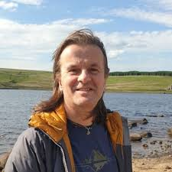
WHO CAN YOU SPEAK TO AT SCHOOL?
Mrs Arif
Alastair
Mrs Watson

Slide 10
ANTI-BULLYING WEEK 2024
Monday 18th to
Friday 22nd November
Odd Socks
Day 2024
Monday 18th November

